Slide 1
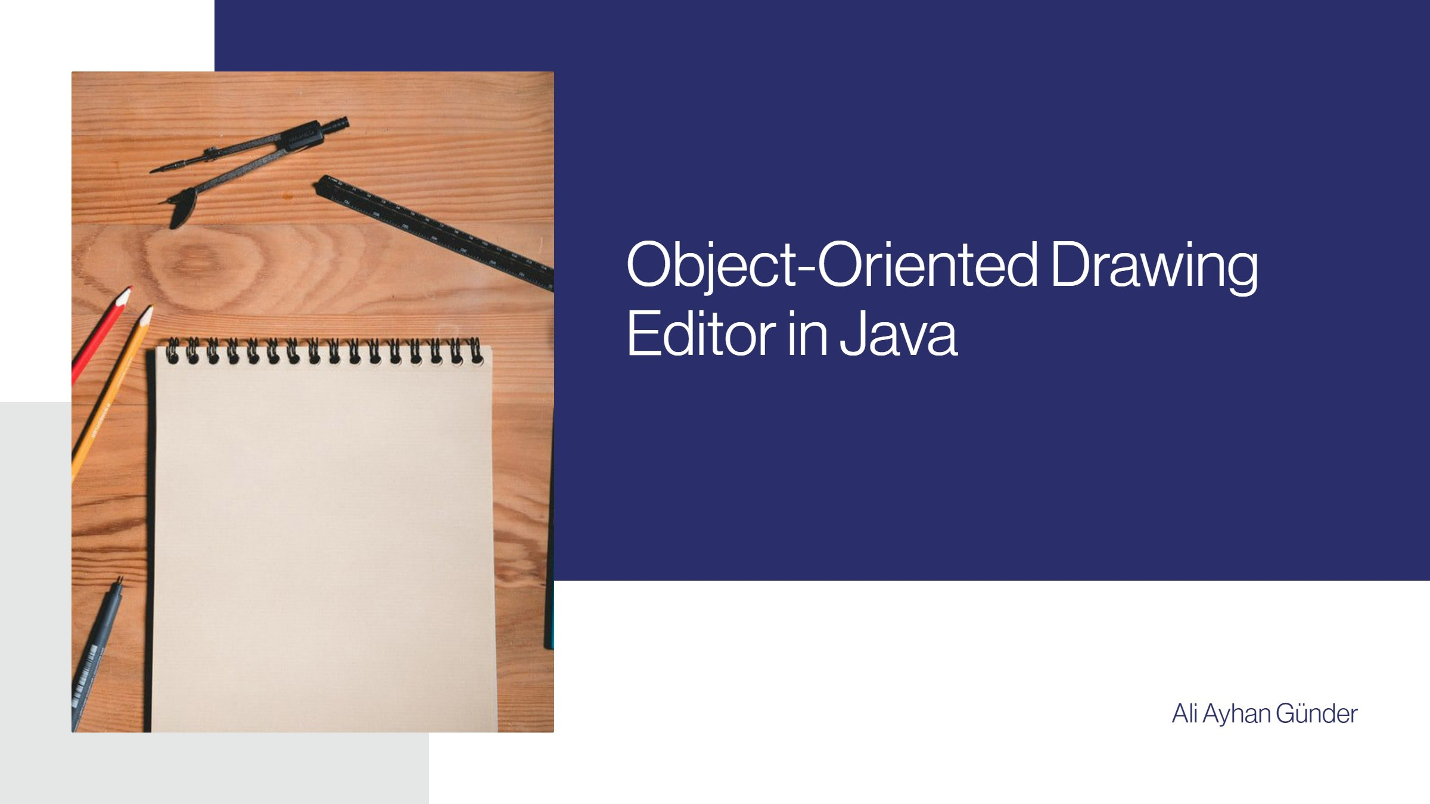


Slide 2





Project Overview
A simple object-oriented drawing editor.
An application designed to create and manipulate graphical objects using OOP principles.
Key Technologies: Java, Swing for GUI, AWT for 2D graphics.
Utilizes Java programming language along with Swing for building the graphical user interface and AWT for rendering 2D graphics.
Core Purpose: To illustrate fundamental Object-Oriented Programming (OOP) principles.
The editor serves as an interactive tool for demonstrating essential OOP concepts in a practical setting.
^œn'ea 1°nç
preseutotions

Slide 3
OOP Principles in Action
Inheritance allows concrete shape classes to inherit common behaviors from the abstract Shape class.
Shape (abstract base class) defines common behaviors (draw, contains, move). Concrete shape classes (Circle, Square, Line, StylusPath) inherit from Shape.
Polymorphism enables dynamic method execution based on the actual shape type.
DrawingPanel iterates through a List and calls shape.draw(g2d). The specific draw method executed depends on the actual type of the shape (e.g., Circle.draw for a Circle).
Encapsulation controls access to Shape properties through public getters and setters.
Shape properties (e.g., x, y, color) are protected. Access is controlled via public getters and setters.
Abstraction defines a common interface while hiding implementation details.
The Shape class abstracts the common interface for all drawable objects, hiding implementation details from the DrawingPanel.
Separation of concerns improves code management by dividing responsibilities between components.
DrawingPanel manages the drawing logic and display. hw1 (main frame) handles UI elements, event listeners, and overall application state.
^œn'ea 1°nç
preseutotions

Slide 4
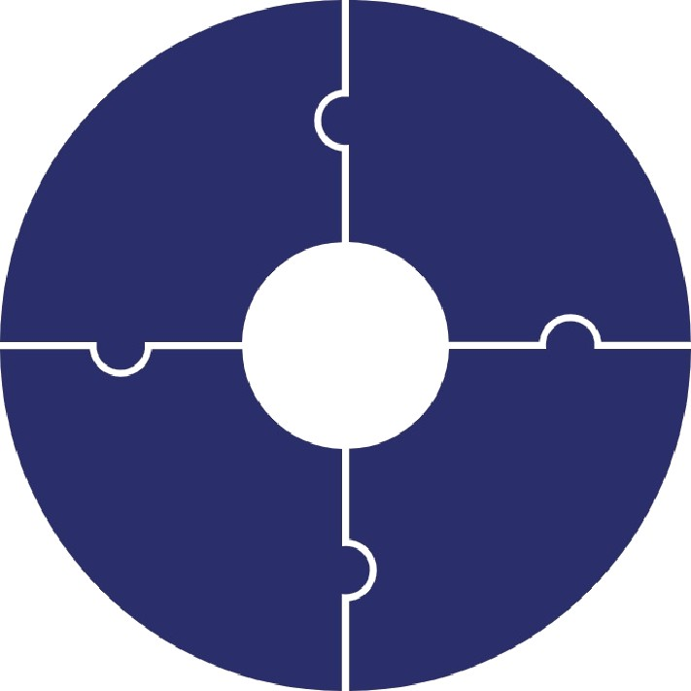
Key Features
Multiple Drawing Tools: Circle, Square, Line, Stylus (freehand drawing).
Shape Customization: Adjustable Size/Thickness via Slider, Selectable Colors via Dropdown.
Dynamic UI Feedback: Instructions label updates based on selected tool and
actions.
Interaction: Shape Selection and Movement (drag & drop), Eraser Tool (click/drag to erase), 'Clean All' button to clear the canvas.
^œn'ea 1°nç
preseutotions

Slide 5








Core Components & Classes
Shape (Abstract Class) defines common attributes and methods.
It includes abstract methods like draw, contains, and move.
Concrete Shape Classes implement specific methods for geometry.
Classes such as Circle, Square, and Line handle their own drawing and selection.
StylusPath manages freehand drawing representation.
It maintains a list of Point objects
and checks proximity to path
Sh_{e+}e_{’l}tS
EraserPath simulates erasing by drawing in the background color.
It extends StylusPath functionality for erasing shapes.
^œn'ea 1°nç
preseutotions

Slide 6
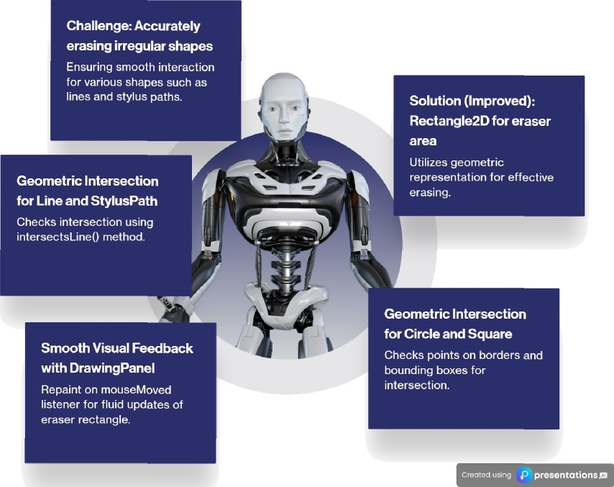
Eraser Implementation Deep Dive

Slide 7

Challenges & Learning
Geometric Hit-Testing
Precisely detecting clicks/erasure on lines and irregular shapes (StylusPath) was a key challenge. Leveraging Line2D.ptSegDist from Java AWT proved crucial for accuracy.
Swing Event Handling
Managing different tool states and mouse interactions (single-click, drag, two-click line) required careful event management.
Refactoring
Identifying and extracting 'magic numbers' into constants improved readability and
maintainability.
UI Responsiveness
Ensuring the application remains fluid during drawing and dragging operations, especially with many shapes.
’œn'eó'1°nç preseutotions

Slide 8

Future Enhancements
More complex shapes (e.g., Triangle,
Polygon, Text).
Undo/Redo functionality.
Resizing shapes after creation.
Save/Load drawings.
More advanced selection (e.g., marquee
select).
Grouping shapes.
^œn'ea 1°nç preseutotions

Slide 9

Questions & Discussion
Than k you Please leel Íree to ask any ques tions you may have.

